Slide 1
Storing & Managing Data
Jeremy Bergmann - Omaha Data Science Academy

Slide 2
Review: Class 4
Create and delete views Perform joins - inner, outer and left Clean string, numeric, and date data SQL Operators, Wildcards, Like, etc. Case Statements & Logical Functions
Union & Union All
Notes:
Feynman technique: Learn -> Explain -> Reflect -> Repeat
What are the most important ideas from last class? Write a summary of the information as if explaining to a 14 year old. Avoid jargon Keep the words and sentences simple Rely on memory Make the explanation visual, if possible Note where you had difficulty or have knowledge gaps. These indicate things you should review, research, or ask questions about

Slide 3
Class 5 Objectives
Data Storage Terminology
Data Management vs. Administration (DBA) Data Governance & Measuring Data Quality
Data Dictionaries
ETL & Data Storage: Python & Other Tools
Data Warehouse vs. Operational/Transactional Data Stores
Notes:
Feynman technique: Learn -> Explain -> Reflect -> Repeat
What are the most important ideas from last class? Write a summary of the information as if explaining to a 14 year old. Avoid jargon Keep the words and sentences simple Rely on memory Make the explanation visual, if possible Note where you had difficulty or have knowledge gaps. These indicate things you should review, research, or ask questions about

Slide 4
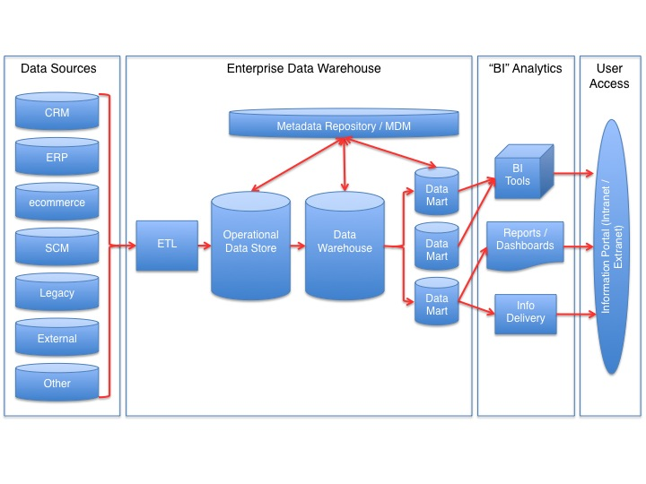
Data Storage Terminology
Semantic Layer
OLTP - Focused on the operation of a particular system - goal is to capture events.
ODS - “pulls together” data from multiple transaction processing systems and sources. Usually contains cleaned, “normalized” data
OLAP - capabilities to analyze data from multi-dimensional perspectives. Usually contains “denormalized” data
MDM: Define and manage the critical data of an organization to provide, with data integration, from a single point of reference.
(ODS)
Online Analytical Processing
(OLAP)
Online Transactional Processing
(OLTP)
Notes:
Relationship: OLTP = Source for OLAP

Slide 5
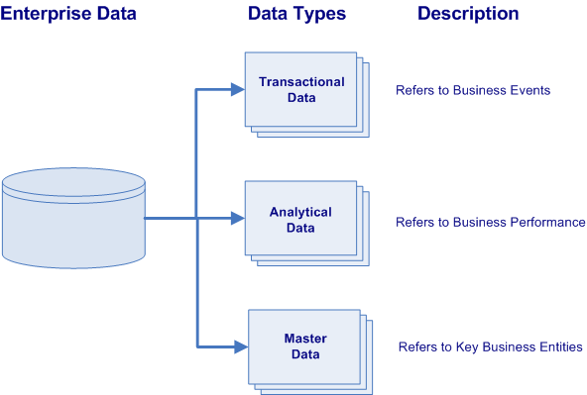
Types of Enterprise Data
All business enterprises have three varieties of physical data located within their numerous information systems. These varieties of data are characterized by their data types and their purpose within the organization.
Transactional Data describes the business events of an organization
Analytical Data supports decision making, reporting, query, and analysis (i.e. describes business performance).
Master Data represents the key business entities upon which transactions are executed and the dimensions around which analysis is conducted (i.e. describes key business entities).
Notes:
Transactional data supports the daily operations of an organization (i.e. describes business events).
Analytical data supports decision-making, reporting, query, and analysis (i.e. describes business performance).
While master data represents the key business entities upon which transactions are executed and the dimensions around which analysis is conducted (i.e. describes key business entities).
lowest granularity

Slide 6
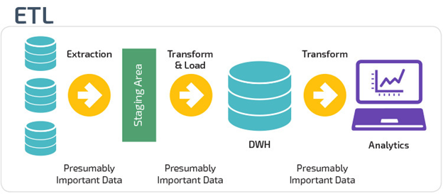
What is ETL?
ETL is short for Extract, Transform, and Load. These functions that let you take data from different formats, manipulate the data in a staging area, then write data to a target database.
The Extract stage lets you take data from different sources and allows you to pull it into a centralized staging area.
The Transform stage lets you manipulate the data with certain rules applied on the extracted data.
The goal is to load this data into the end, target database in a cleansed, uniform format.
The Load stage is the process of writing the data into the final, target database. This final target can be an operational data store, data marts, or a data warehouse.
Notes:
For example, a company may house all their data in a SQL Server database, but needs to gather their source data from Excel, CSV, Access, and JSON files. With ETL, you can take this disparate information, pull it into a staging area where you transform it, then write all the data into the target data store.

Slide 7
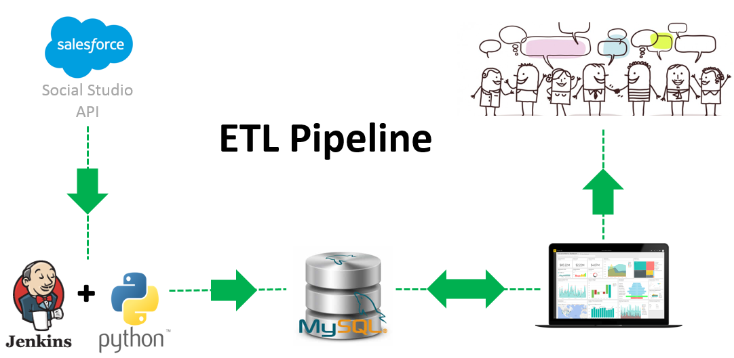
ETL Using Python
You can run an ETL process with either an ETL tool or by running scripts you design yourself. While there are many software based ETL tools on the market, it’s becoming more and more common to create ETL processes using a scripting language.
Why Python for ETL?
Common language for data scientists and data engineers.
Libraries that include ETL processes and connections to a variety of data sources
Databases, Files, APIs, etc.
Flexible - Adjust “on the fly” to specific project needs.
The processes are also known as “Python Pipelines”.
Python ETL & Data-Cleaning Example - Google Drive - Jupyter Notebook
Notes:
Note: Install Pandas, Numpy & PyMySQL packages
Run Python from Command-line in Windows:
Save your python code file somewhere, using "Save" or "Save as" in your editor. Lets call it 'first.py' in some folder, like "pyscripts" that you make on your Desktop.
Open a prompt (a Windows 'cmd' shell that is a text interface into the computer):
start > run > "cmd" (in the little box). OK.
Navigate to where your python file is, using the commands 'cd' (change directory) and 'dir' (to show files in the directory, to verify your head). For our example something like,
> cd C:\Documents and Settings\Gregg\Desktop\pyscripts
try:
> python first.py

Slide 8
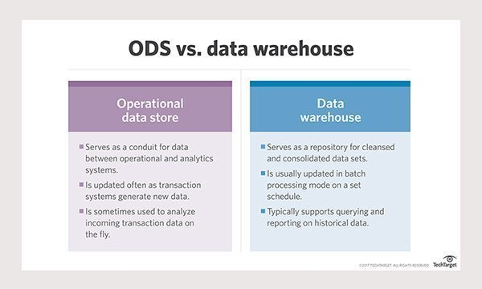
Operational Data Store vs. Data Warehouse
ODS Benefits: Holds detailed data in raw format, improved data integration, frequently updated - often used for real-time analytics
DW Benefits: Data Integration, maintain historical business results, improved data management, consistency and availability of data.

Slide 9
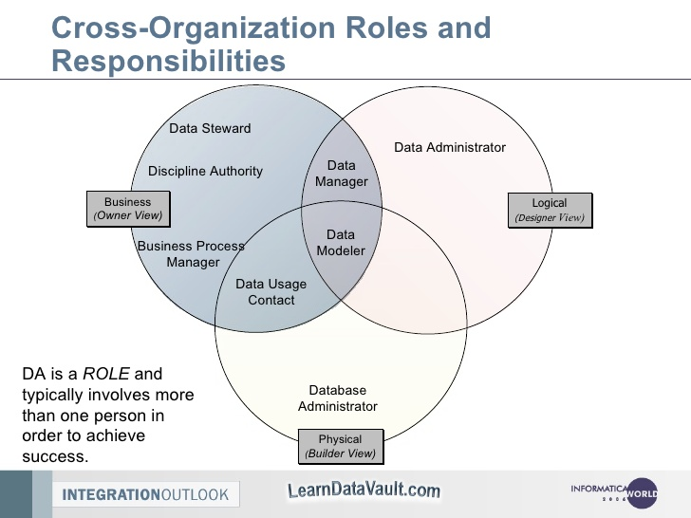
Data Management vs. DBA
What is Data Management?
Data Management is the practice of organizing and maintaining data processes to meet ongoing information lifecycle needs. Approaches to data management eventually created the Data Lifecycle. This includes data creation, storage, processing, archiving, and data destruction.
What is Database Administration (DBA)?
Database administration is the use of specialized software to store and organize data. This is the technical aspects of the planning, installation, configuration, design, migration, performance monitoring, security, troubleshooting, backup, and data recovery of a database system.
What are the Similarities Between the Two Roles?
Professionals in both specializations have to coordinate the database planning, goals, and design, and communicate with each other while the project is being implemented..
What are the Differences?
Data management focuses on the “Logical” design - planning, organization, and design of a database system. DBA’s focus in the physical design of the database performance, storage, access, backups, etc.
Notes:
Approaches to data management eventually permeated what came to be known as the data lifecycle, spanning data creation, storage, processing, archiving and, sometimes, data destruction.

Slide 10
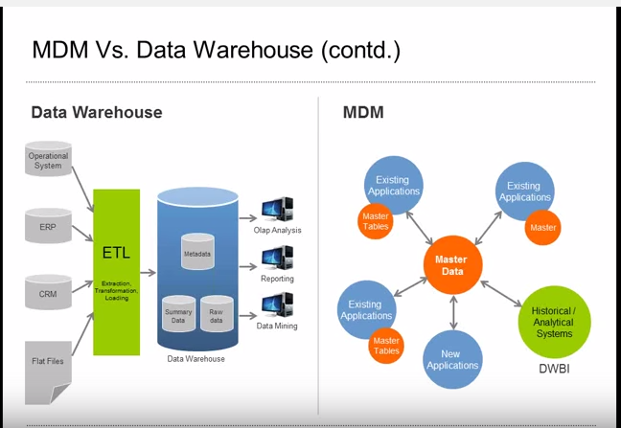
Master Data Management vs. DW
Different Goals
The main purpose of a data warehouse is to analyze data in a multidimensional fashion, while the main purpose of MDM is to create and maintain a single source of truth for a particular dimension within the organization.
Different Types of Data
Master Data Management is only applied to entities and not transactional data, while a data warehouse includes data that are both transactional and non-transactional in nature.
Different Reporting Needs
In data warehousing, it is important to deliver to end users the proper types of reports using the proper type of reporting tool to facilitate analysis.
In MDM, the reporting needs are very different -- it is far more important to be able to provide reports on data governance, data quality, and compliance, rather than reports based on analytical needs.
Notes:
n addition, MDM requires solving the root cause of the inconsistent metadata, because master data needs to be propagated back to the source system in some way. In data warehousing, solving the root cause is not always needed, as it may be enough just to have a consistent view at the data warehousing level rather than having to ensure consistency at the data source level.

Slide 11
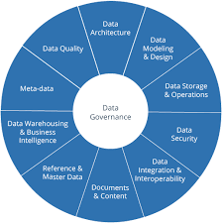
Data Governance
What is Data Governance?
Data Governance is a quality control discipline for assessing, managing, using, improving, monitoring, maintaining, and protecting organizational information.
Who Needs Data Governance?
Most organizations should have some form of data governance to prevent sensitive information from getting into the wrong hands. However, large companies and regulated industries, such as healthcare or banking, have the most at stake.
What is a Data Steward?
This is a position within an organization that ensures data governance processes are followed, guidelines are enforced, and recommends improvements to be made to data governance processes.
Notes:
It is a system of decision rights and accountabilities for information-related processes, executed according to agreed-upon models which describe who can take what actions with what information, and when, under what circumstances, using what methods

Slide 12
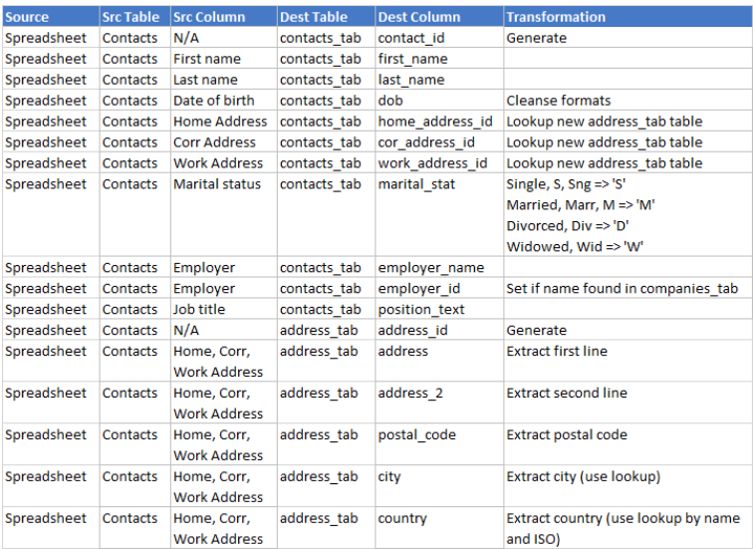
Data Dictionaries
What is a Data Dictionary?
A Data Dictionary is a collection of sources, names, definitions, and attributes about data elements that define the data captured in a system.
The data dictionary in general contains information about the following:
Names and physical information of all database schemas, tables and fields.
“System of record” information about fields/tables.
Table constraints such as primary key attributes, foreign key information etc.
Business rules, transformations and metadata about field values.

Slide 13
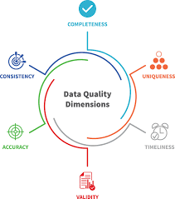
Measuring Data Quality
What is Data Quality?
Sometimes errors or incorrect elements are present in your data set. It’s important to be proactive and clean your data and periodically test it for inaccuracies.
What is a Data Quality Assessment?
You can identify these errors and understand their implications by both qualitative assessments and quantitative measurement. This ensures you have quality data on hand when you run your jobs. This will let you improve your data quality processes for quality and effectiveness.
What is an Example of Measuring Data Quality?
This is a common type of data quality metric. It allows you to track how the number of known errors – such as missing, incomplete or redundant entries – within a data set corresponds to the size of the data set. If you find fewer errors while the size of your data stays the same or grows, you know that your data quality is improving.

Slide 14
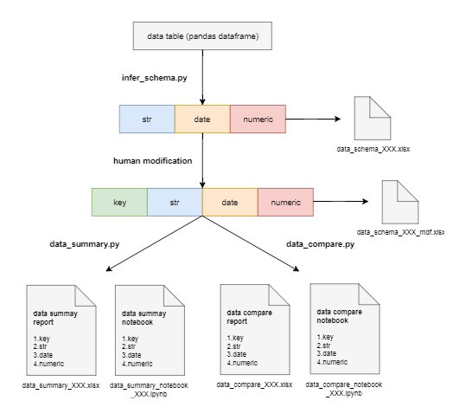
Measuring Data Quality w/Python
There are ways to monitor and measure data quality with Python. Some of these libraries can help with the following tasks:
Data Integration
Data Cleansing
Data Monitoring
Data Auditing
Investigating
Unknown Datasets
To the right, you can see an example of a Python library: pydqc.
You can use libraries like this to set up a notebook to
import libraries like pandas to clean data, numpy to run
calculations, and pydqc to add automatic data quality checks.
It lets you load the data (CSV), infer the schema of your
database, and generate a summary of your data.
https://github.com/SauceCat/pydqc
https://github.com/SauceCat/pydqc/blob/master/test/pydqc_test_on_Zillow.ipynb

Slide 15

Exercises - Class Project
ETL
1. Utilize the Python ETL Code to load CSV file data into you MySQL database tables
Google Cloud
1. Return the names of all cities contained in the world.city table that are in Nebraska (Region), using a subquery
2. In the world.country langage table, select all countries where the official language is ‘English’
3. In the world.country table, compare the average life expectancy of people, in a variety of ways.

